Slide 1
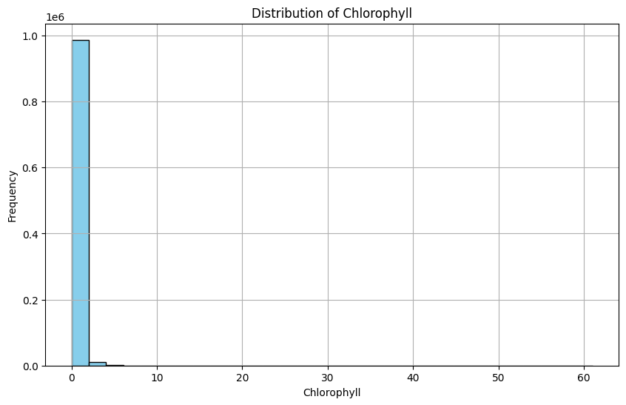
資料描述
原始數據的描述性統計量:
count 1000000.000000
mean 0.296983
std 0.444100
min 0.000000
25% 0.102800
50% 0.169073
75% 0.346958
max 61.048622
Name: Chlorophyll, dtype: float64

Slide 2
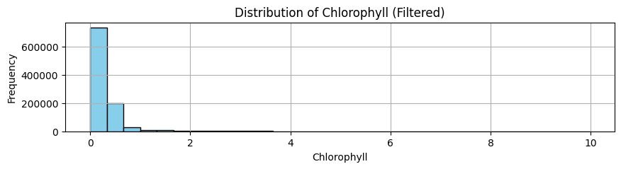
隨機1000000筆(10%)且只取葉綠素<10 資料描述
原始數據的描述性統計量:
count 1000000.000000
mean 0.296983
std 0.444100
min 0.000000
25% 0.102800
50% 0.169073
75% 0.346958
max 61.048622
Name: Chlorophyll, dtype: float64
過濾後數據的描述性統計量:
count 999934.000000
mean 0.295948
std 0.419967
min 0.000000
25% 0.102797
50% 0.169054
75% 0.346909
max 9.978419
Name: Chlorophyll, dtype: float64

Slide 3
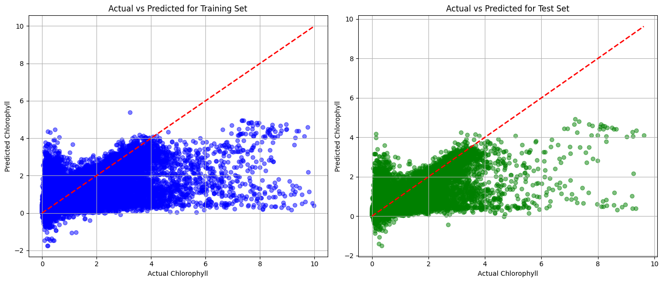
隨機1000000筆(10%)且只取葉綠素<10 nn第一版
MLP best parameters: {'activation': 'relu', 'alpha': 0.0001, 'hidden_layer_sizes': (100,), 'learning_rate_init': 0.1}
Train MAE: 0.10842573808881481
Test MAE: 0.10927382391478477
Train RMSE: 0.26010855346497097
Test RMSE: 0.26443855430392676
Train R2: 0.6156134690845501
Test R2: 0.6067404517068028

Slide 4
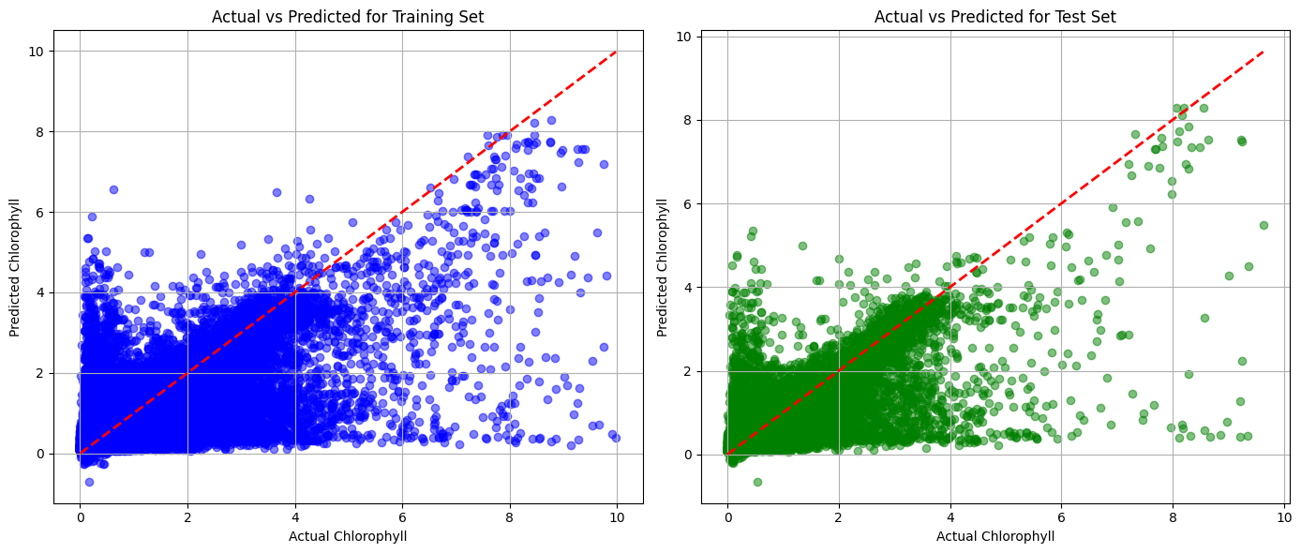
隨機1000000筆(10%)且只取葉綠素<10 nn第二版
MLP best parameters: {'activation': 'relu', 'alpha': 0.0001, 'hidden_layer_sizes': (100, 100, 50), 'learning_rate_init': 0.001}
Train MAE: 0.09356974035272059
Test MAE: 0.0949235001270268
Train RMSE: 0.23697668520333015
Test RMSE: 0.247703550870906
Train R2: 0.6809416357510665
Test R2: 0.6549403382284504

Slide 5
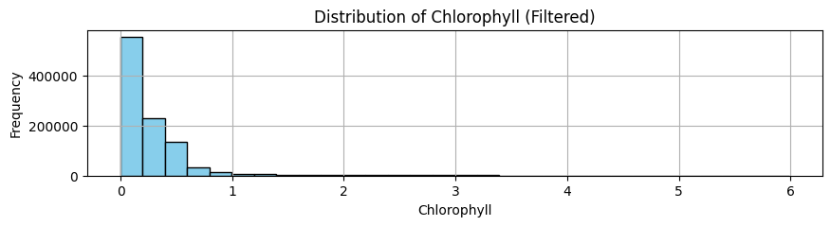
隨機1000000筆(10%)且只取葉綠素<6 資料描述
原始數據的描述性統計量:
count 1000000.000000
mean 0.296983
std 0.444100
min 0.000000
25% 0.102800
50% 0.169073
75% 0.346958
max 61.048622
Name: Chlorophyll, dtype: float64
過濾後數據的描述性統計量:
count 999495.000000
mean 0.292828
std 0.392263
min 0.000000
25% 0.102780
50% 0.168962
75% 0.346545
max 5.984197
Name: Chlorophyll, dtype: float64

Slide 6
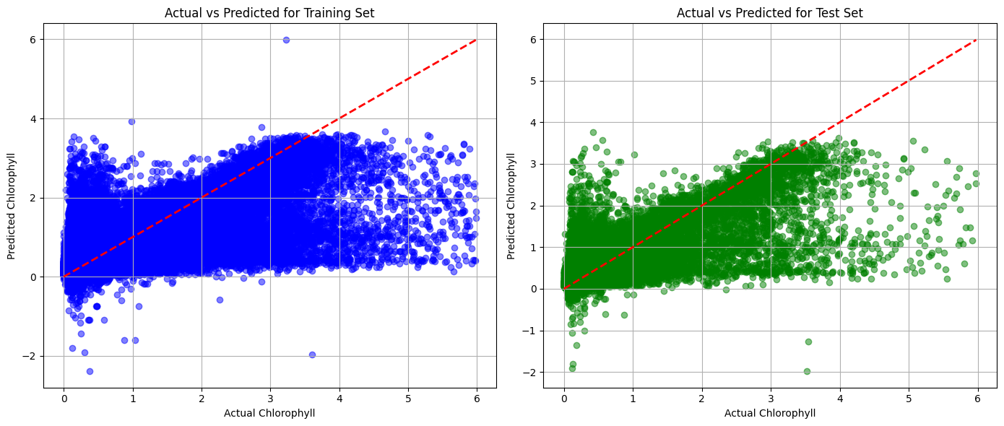
隨機1000000筆(10%)且只取葉綠素<6 nn第一版
MLP best parameters: {'activation': 'relu', 'alpha': 0.0001, 'hidden_layer_sizes': (100,), 'learning_rate_init': 0.1}
Train MAE: 0.10079427424912571
Test MAE: 0.10023857114359973
Train RMSE: 0.2325742597945181
Test RMSE: 0.2332532080796151
Train R2: 0.6487712046271277
Test R2: 0.6451673945044233

Slide 7
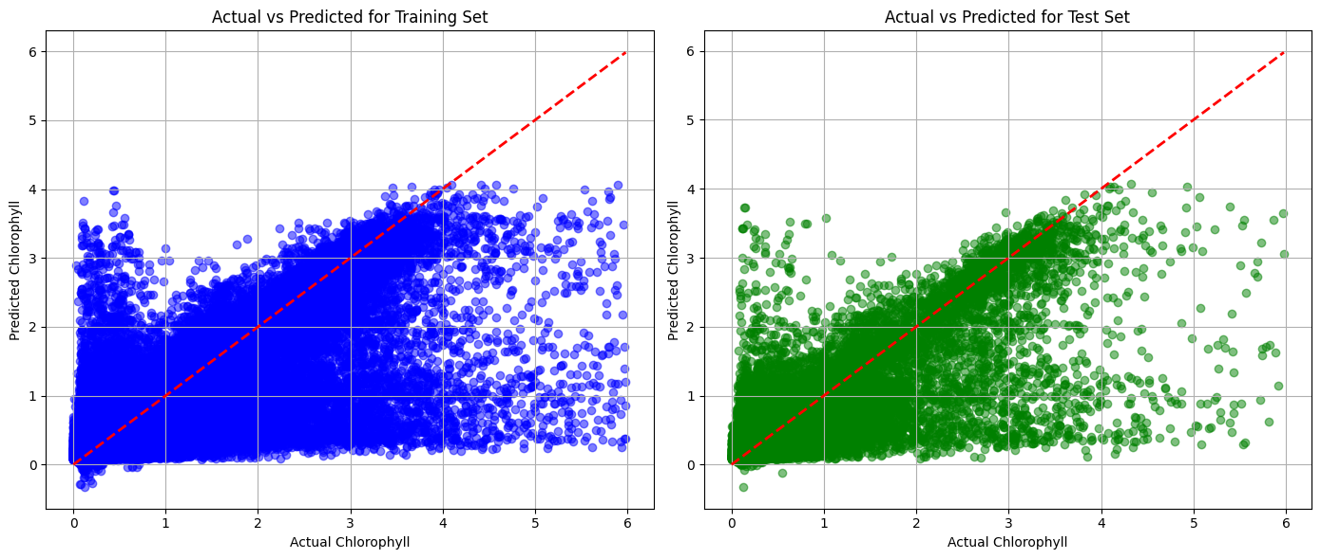
隨機1000000筆(10%)且只取葉綠素<6 nn第二版
MLP best parameters: {'activation': 'relu', 'alpha': 0.0001, 'hidden_layer_sizes': (100, 100, 50), 'learning_rate_init': 0.001}
Train MAE: 0.09004519069144917
Test MAE: 0.08955270586608137
Train RMSE: 0.21975450116053077
Test RMSE: 0.22050523946982362
Train R2: 0.6864243161608595
Test R2: 0.6828928053193589

Slide 8
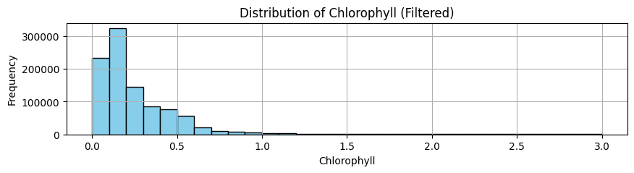
隨機1000000筆(10%)且只取葉綠素<3 資料描述
原始數據的描述性統計量:
count 1000000.000000
mean 0.296983
std 0.444100
min 0.000000
25% 0.102800
50% 0.169073
75% 0.346958
max 61.048622
Name: Chlorophyll, dtype: float64
過濾後數據的描述性統計量:
count 994714.000000
mean 0.276797
std 0.314613
min 0.000000
25% 0.102577
50% 0.167827
75% 0.342770
max 2.999929
Name: Chlorophyll, dtype: float64

Slide 9
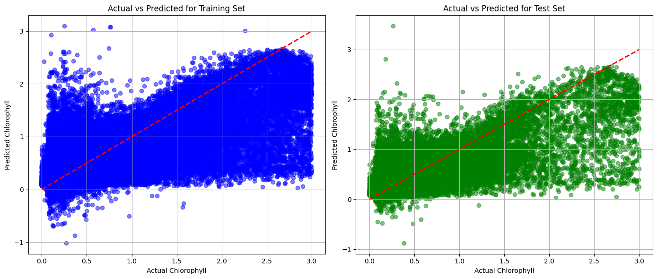
隨機1000000筆(10%)且只取葉綠素<3 nn第一版
MLP best parameters: {'activation': 'relu', 'alpha': 0.001, 'hidden_layer_sizes': (100,), 'learning_rate_init': 0.1}
Train MAE: 0.0763258929848402
Test MAE: 0.07690421831479494
Train RMSE: 0.12979546735147313
Test RMSE: 0.13126749952533517
Train R2: 0.6328927042921375
Test R2: 0.6271505460475207

Slide 10
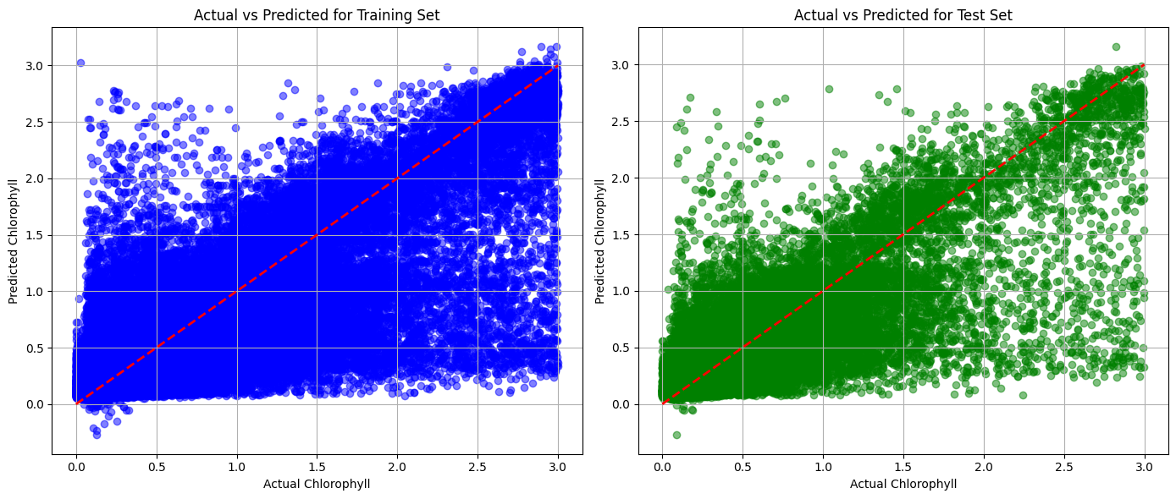
隨機1000000筆(10%)且只取葉綠素<3 nn第二版
MLP best parameters: {'activation': 'relu', 'alpha': 0.0001, 'hidden_layer_sizes': (100, 100, 50), 'learning_rate_init': 0.001}
Train MAE: 0.0823405594214791
Test MAE: 0.08297081339506747
Train RMSE: 0.16900557885977746
Test RMSE: 0.17160128401100794
Train R2: 0.7111231816853849
Test R2: 0.7037591713176816

Slide 11
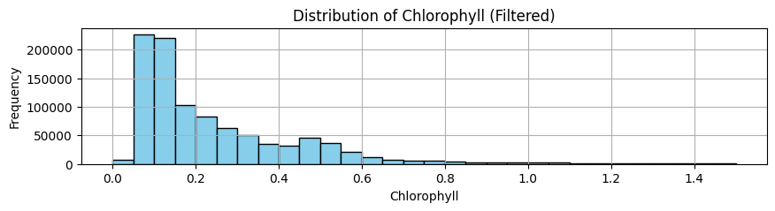
隨機1000000筆(10%)且只取葉綠素<1.5 資料描述
原始數據的描述性統計量:
count 1000000.000000
mean 0.296983
std 0.444100
min 0.000000
25% 0.102800
50% 0.169073
75% 0.346958
max 61.048622
Name: Chlorophyll, dtype: float64
過濾後數據的描述性統計量:
count 980379.000000
mean 0.249593
std 0.214373
min 0.000000
25% 0.101983
50% 0.164405
75% 0.331769
max 1.499840
Name: Chlorophyll, dtype: float64

Slide 12
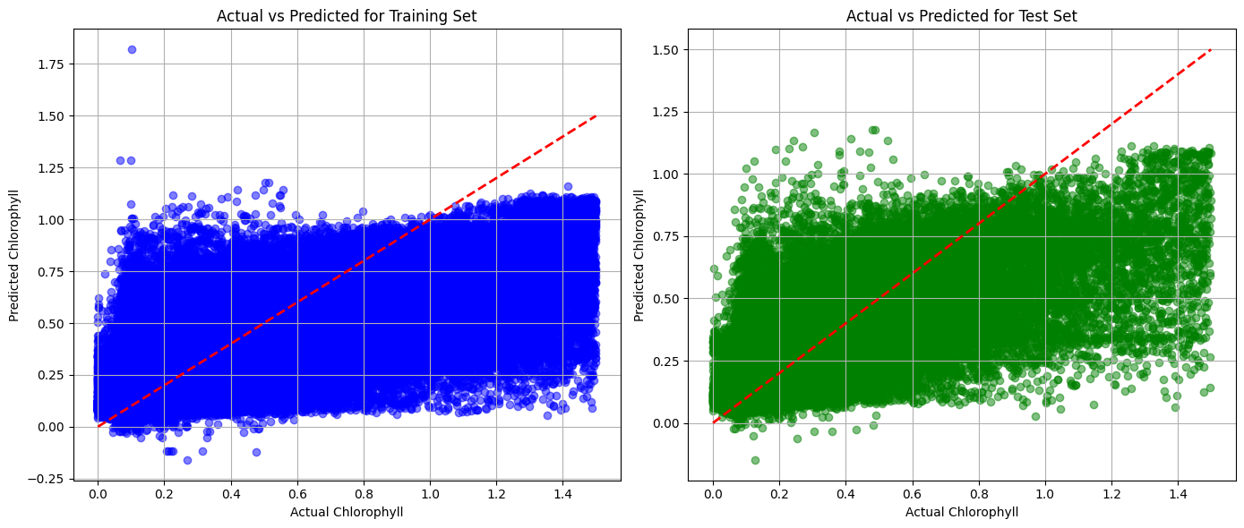
隨機1000000筆(10%)且只取葉綠素<1.5 nn第一版
MLP best parameters: {'activation': 'relu', 'alpha': 0.001, 'hidden_layer_sizes': (100,), 'learning_rate_init': 0.1}
Train MAE: 0.0763258929848402
Test MAE: 0.07690421831479494
Train RMSE: 0.12979546735147313
Test RMSE: 0.13126749952533517
Train R2: 0.6328927042921375
Test R2: 0.6271505460475207

Slide 13
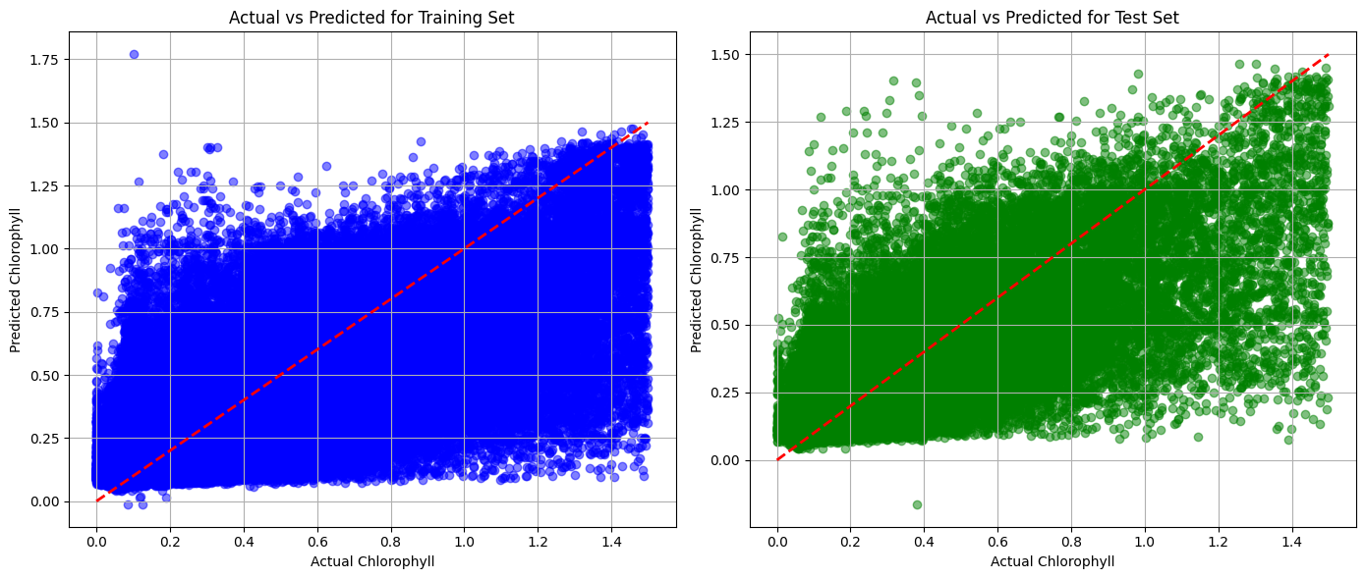
隨機1000000筆(10%)且只取葉綠素<1.5 nn第二版
MLP best parameters: {'activation': 'relu', 'alpha': 0.0001, 'hidden_layer_sizes': (100, 100, 50), 'learning_rate_init': 0.001}
Train MAE: 0.0715839031929735
Test MAE: 0.07234709268565934
Train RMSE: 0.1233529637946711
Test RMSE: 0.12515019737548677
Train R2: 0.6684315951541377
Test R2: 0.6610917320180563

